Slide 1
Introduction to
FIRST LEGO League Challenge Created by FLLTutorials.com

Slide 2
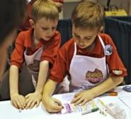
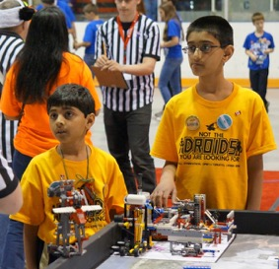
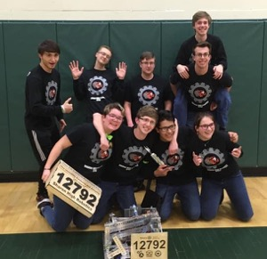
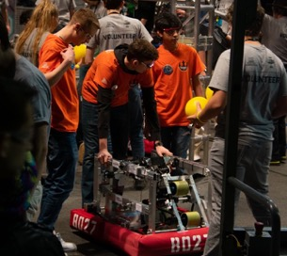
Three FIRST Programs (K-12)
FIRST LEGO League:
Discover
Explore
Challenge
FIRST Tech Challenge
FIRST Robotics Competition

Slide 3
“I don’t use kids to build robots. I use robots to build kids”
- Dean Kamen

Slide 4
Table of Contents
Overview of FIRST LEGO League Challenge
Innovation Project
Robot Game
Robot Design
Core Values
Our Team

Slide 5
Team
North America (ages 9 to 14/grades 4-8); Elsewhere ( ages 9-16)
Check with local organizers for variations
Teams consists of 2-10 students
Two official adult coaches with clearances per team
Kids on the team do the work, coaches/mentors guide the overall process

Slide 6
Approximate Timeline
August 5, 2025: Challenge documents released
August-November 2025: Team meets weekly to solve the challenge
November-December 2025: Qualifiers
December 2025 - February 2026: State/Regional Championship
April 2026: World Championships
May-June 2026: Official Open Invitationals run by Program Development Partners
Timelines vary by region. Contact your local organizers for specifics.

Slide 7
Team Costs
LEGO Robot - approx. $500.00 (Core Set + Expansion Set)
SPIKE Prime, MINDSTORMS EV3, MINDSTORMS Robot Inventor
Purchase from FIRST or directly from LEGO Education
Wooden Robotics Table – approx. $100.00
National Team Registration – $275
Challenge Set - $75 (expect 2%-4% increase)
Local Tournament Registration Cost - $75-250+
Travel Expenses
Team Shirts/Supplies
Cost vary by region. Contact your local organizers for specifics. Above costs are in USD and for North America only.

Slide 8
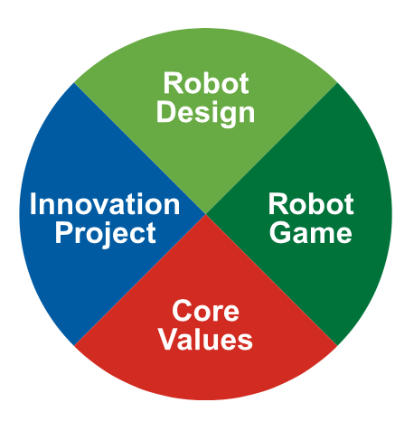
Four Parts of FIRST LEGO League Challenge
Four equally weighted parts Each accounts for 25% of your total performance
Evaluated using rubrics and points scored on the game

Slide 9
Innovation Project

Slide 10
Innovation Project is based on a yearly theme
2024-25 SUBMERGED – Solve a problem related to ocean exploration
2020-21 RePlay Season - Help people get more active
2017-18 Hydrodynamics Season - Improve the way people find, transport, use, or dispose of water
2014-15 World Class – Improve the way we learn something

Slide 11
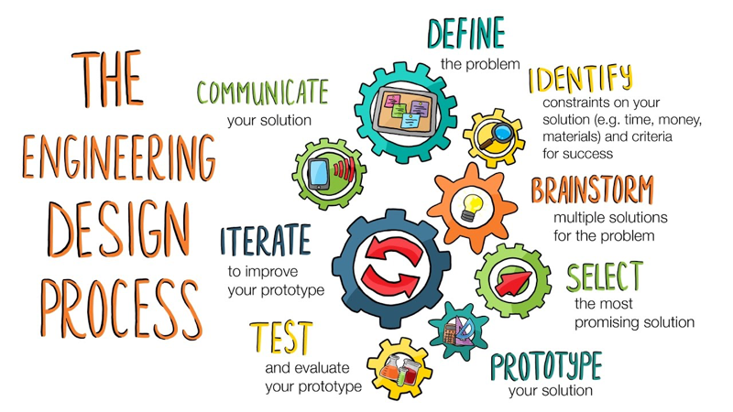
Research Project Process
Identify a problem
Design a solution
Create a prototype
Share the solution
Iterate your design

Slide 12
Sample Project (SUBMERGED)
PROBLEM:
Marine biologists and experts find sampling and carrying seafloor sediments (20 - 40 m) to be difficult
﻿Embedding the corers is hard, even sometimes having to use small hammers to do it
They must be kept in a vertical position to not mix the different layers of collected samples
EXISTING SOLUTIONS
Baskets to transfer corers vertically must be carried by hand
Nets to store the corers can still tip over.
In both cases, balloons can be used to lift samples to the surface, although they must be inflated with air from the diver's tank and their pressure needs to be controlled while ascending
Reproduced with permission from Aldeatrón Robotix, Tenerife Sur

Slide 13

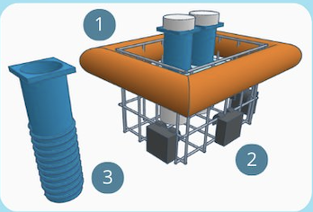
Sample Project (SUBMERGED)
SOLUTION: ScuBasket
Basket that holds 6 corers that descends to the seafloor and comes back up on its own.
1. An inflatable connected to a small CO, bottle activated by the diver, with an automatic valve controlled by pressure.
2. A ballast to control the buoyancy and stability of the corers in vertical position.
3. Each corer has a screw-like shape to make the insertion into the seafloor easier, using a hand crank.
Reproduced with permission from Aldeatrón Robotix, Tenerife Sur

Slide 14
Robot Game

Slide 15
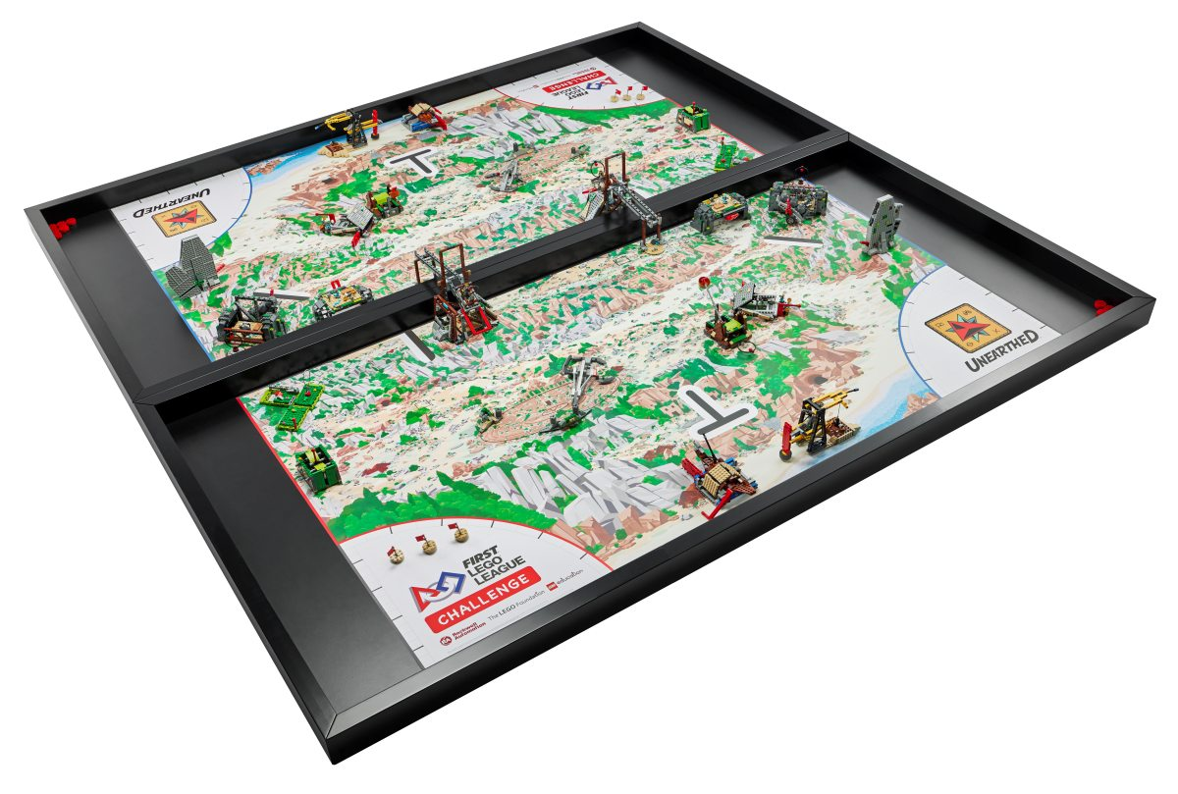
Overview
4ft x 8ft table with a mat
LEGO-based missions
LEGO MINDSTORMS or SPIKE Prime to solve the missions
Theme changes early
2 tables placed next to each other at competition

Slide 16
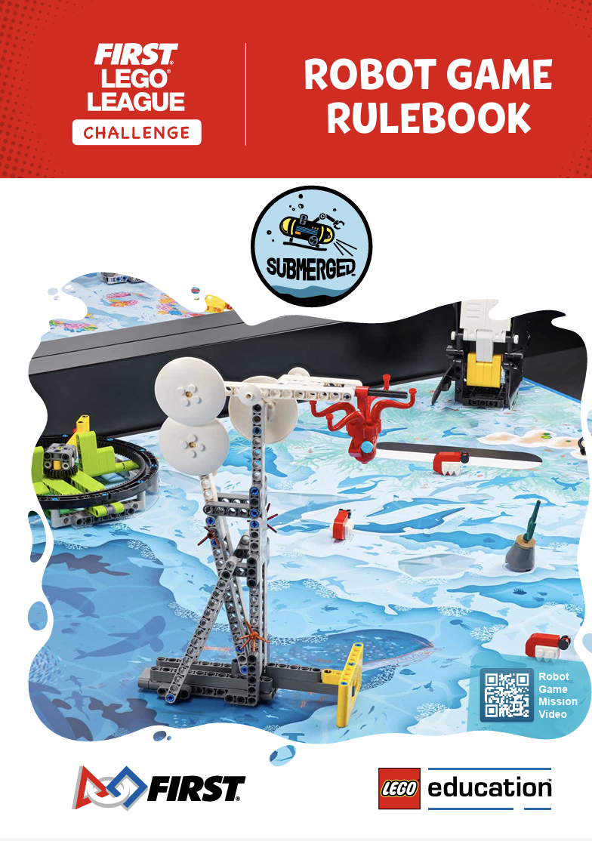
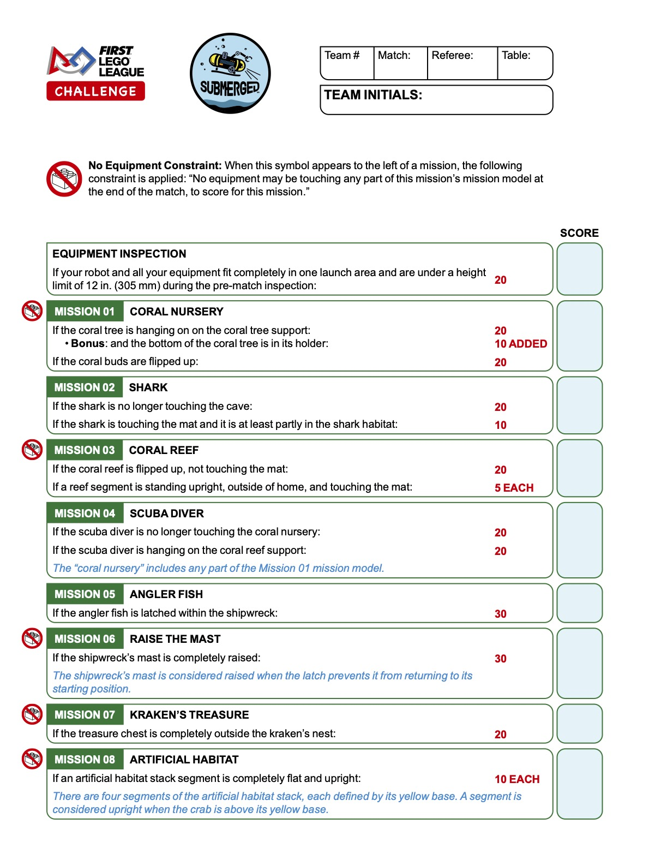
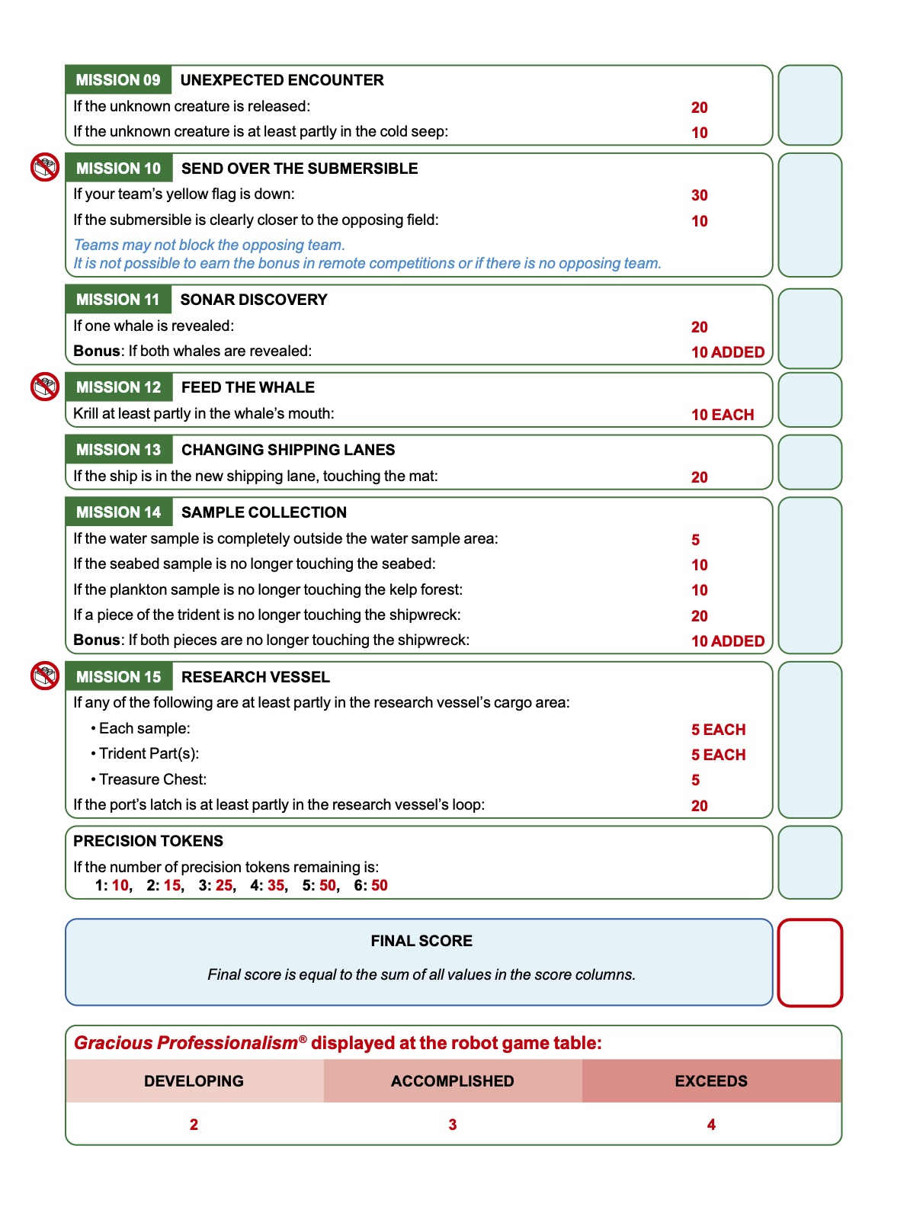
Robot Runs
3 matches, best score counts
2.5 minutes to complete as many missions as you can (Note: majority of teams will not do all the missions)
Points vary by mission
Each mission has its own set of rules and instructions
Referees score you at the end of each match using a scoresheet

Slide 17
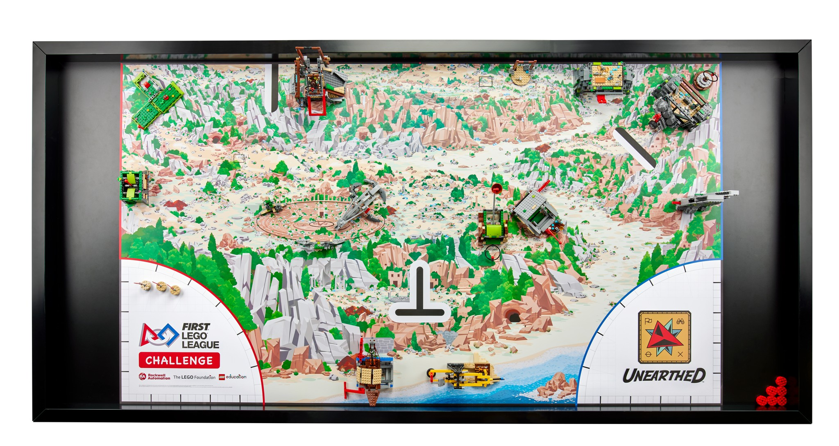
2025-26 Season: UNEARTHED (Archaeology)

Slide 18
Robot Design

Slide 19
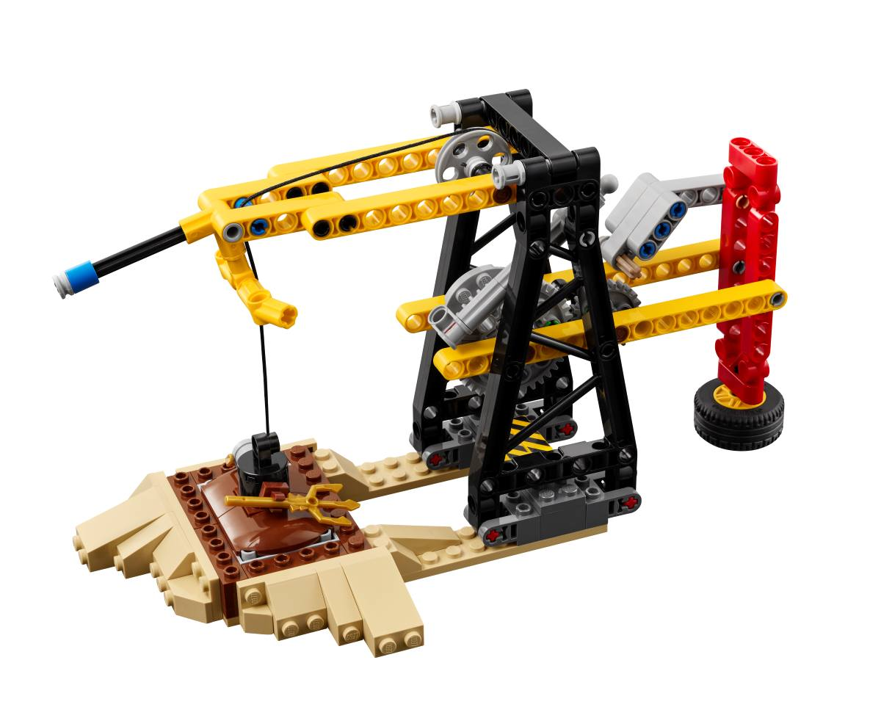
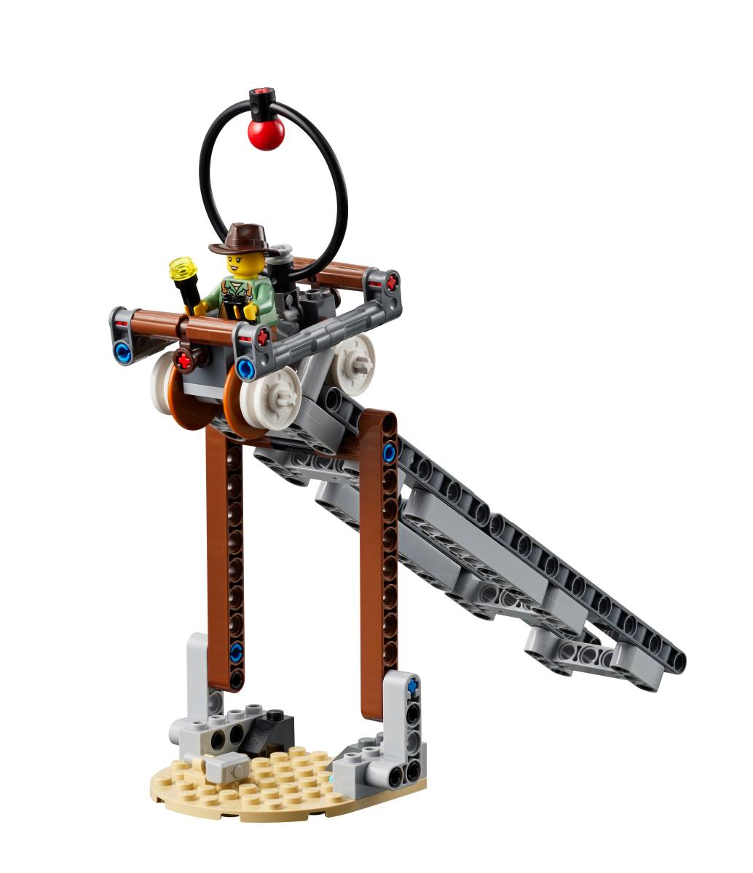
Focus on the Engineering Design Process
Step 1: Analyze the missions and develop a strategy
Step 2: Build and program a robot to meet that strategy
Step 3: Test the robot and make improvements as needed
Step 4: Develop solutions to individual missions
Step 5: Test code and solutions
Step 6: Iterate code and robot as needed
Step 7: Document the process to share with judges

Slide 20
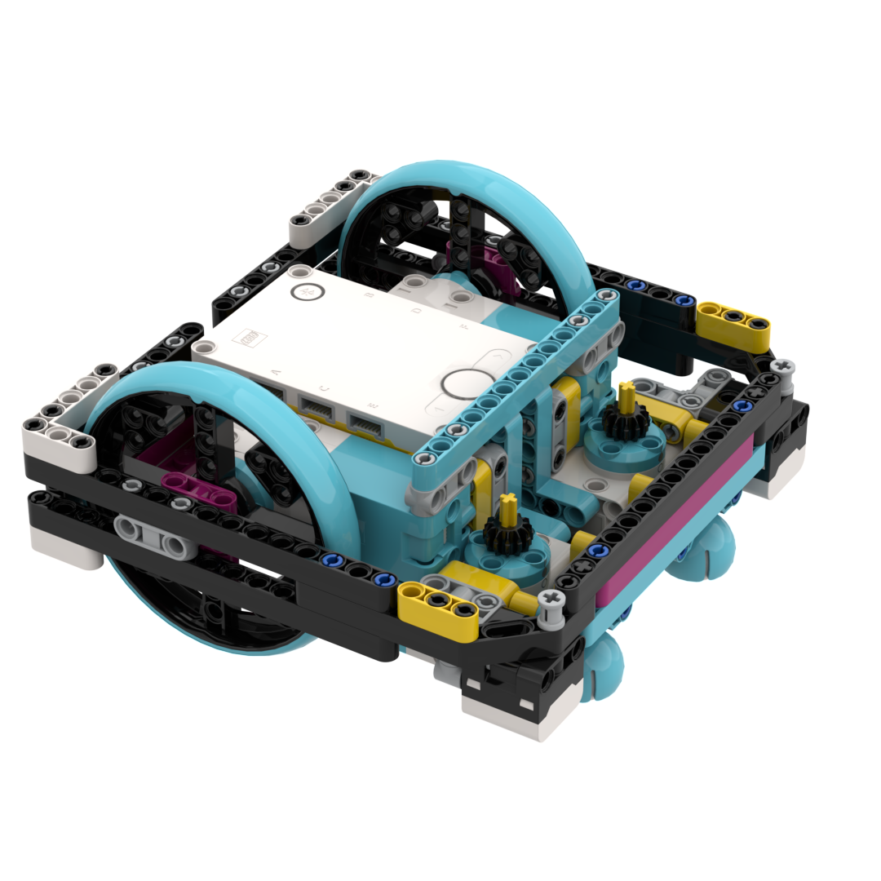
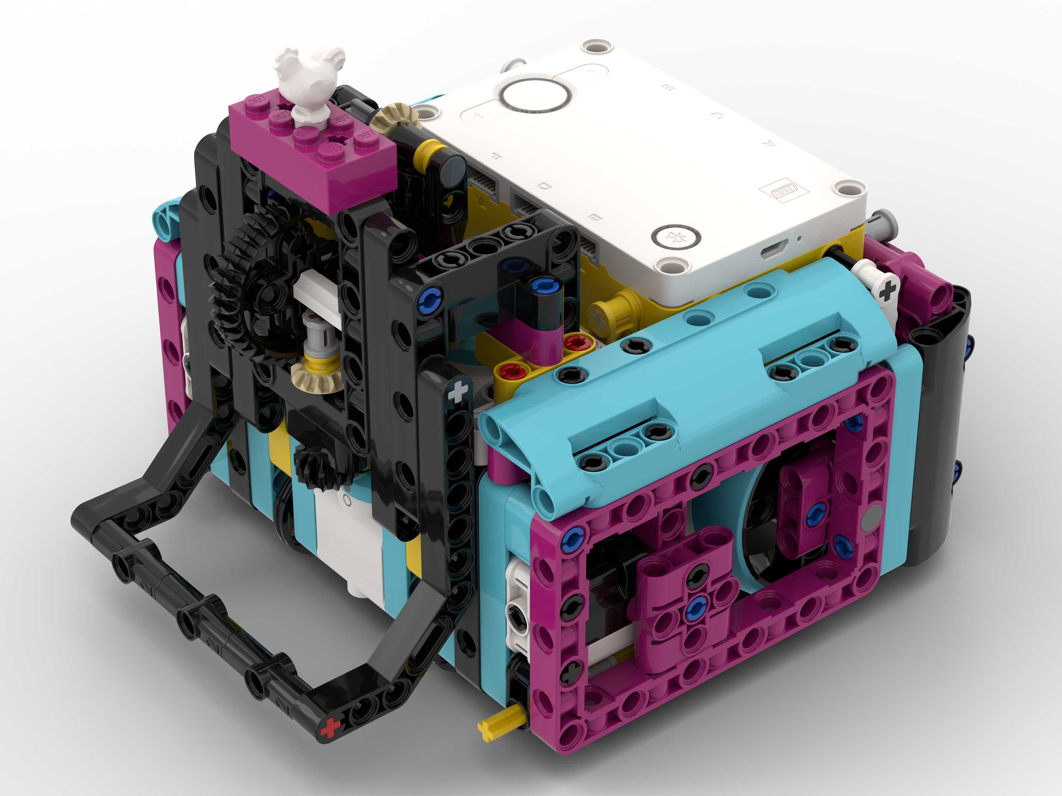
Building and Programming
Programming in block-based or text-based languages
Learn physics and engineering concepts
Optional CAD skills

Slide 21
Core Values

Slide 22
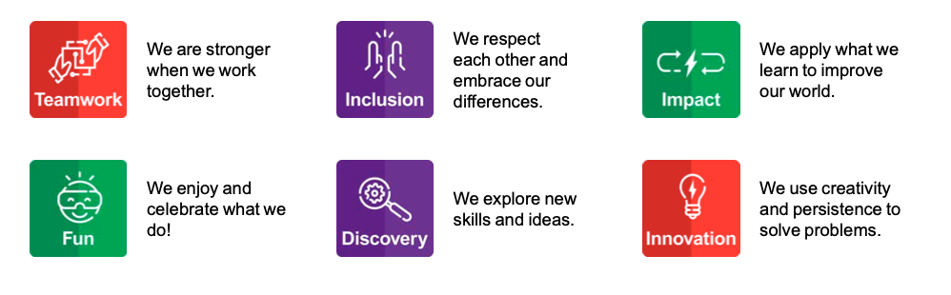
What are Core Values?
The cornerstones of the program
The set of ideas that every FIRST team should live by

Slide 23
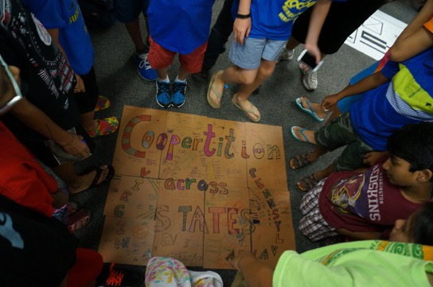
What is Gracious Professionalism and Coopertition?
Gracious Professionalism:
High-quality work, emphasis on the value of others
Respect for individuals and the community.
Competition and mutual gain are not separate notions.
Coopertition:
The idea you should respect and support teams you compete against.

Slide 24
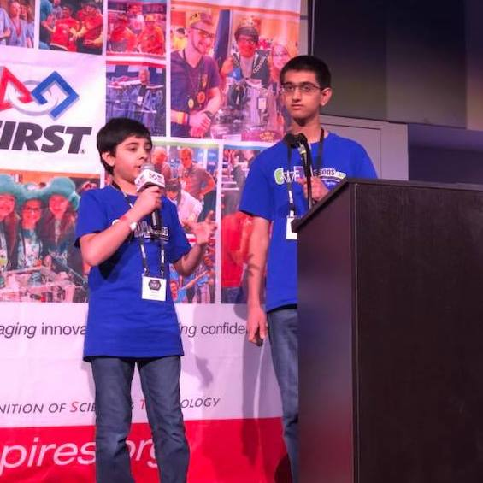
Learning Life Skills through FIRST
Teamwork
Communication
Problem Solving
Helping one another
Giving back to community

Slide 25
Our Team

Slide 26
Meeting Times/Attendance Requirements
Fill in

Slide 27
How do you join the team?
Application
Tryouts
Recommendation Letter

Slide 28
Team Expectations
Cost:
Attendance:
Behavior/Code-of-Conduct:
Parent support and Involvement:

